Slide 1
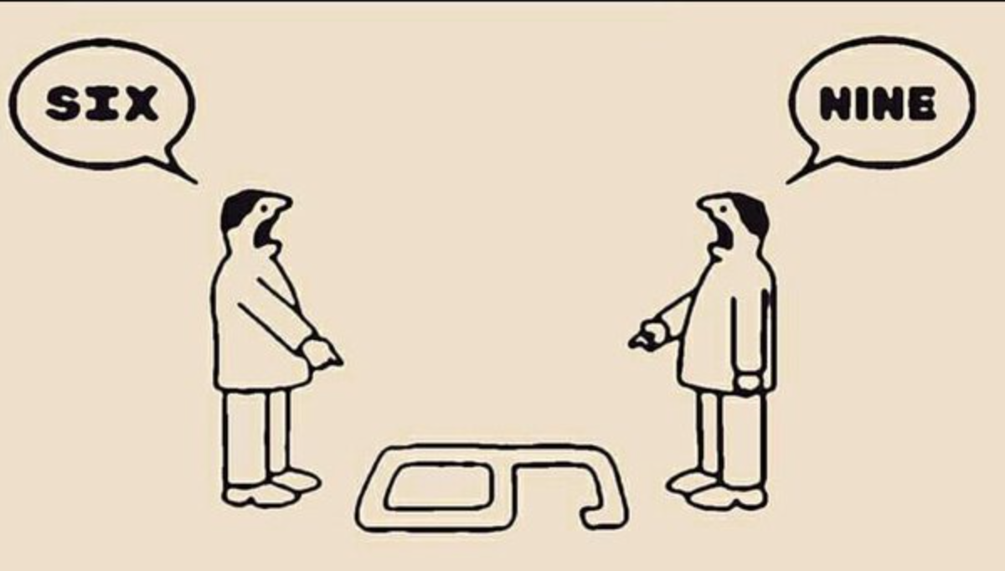
CAN YOU SEE BOTH SIDES?
Notes:
One of the golden rules of journalism is that you should always try to get a balanced view on any story you’re covering. But in reality, that can be quite difficult to achieve. And the exact approach you take to balance might depend on which platform you’re publishing a story. There’s also a discussion to be had around the idea of free speech – and how we express that as journalists. So first, a question for you…

Slide 2
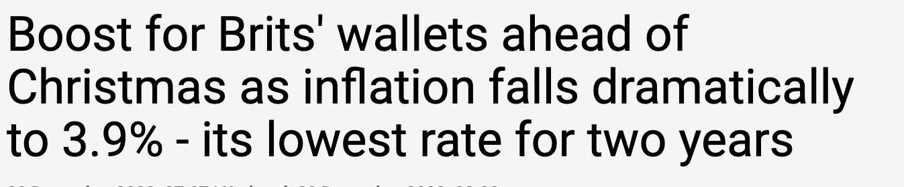
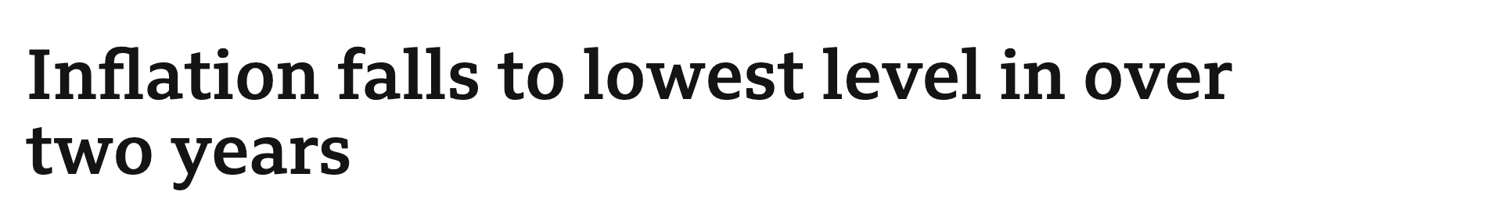
WHICH IS THE BETTER HEADLINE?
A
B
Notes:
These are two headlines that appeared moments after the latest inflation figures were announced. In your view, which is the better headline?
DISCUSSION – which do students pick as being the better headline? If time, a short exercise on what THEY would write. Compare styles, tone and hint towards impartiality.

Slide 3
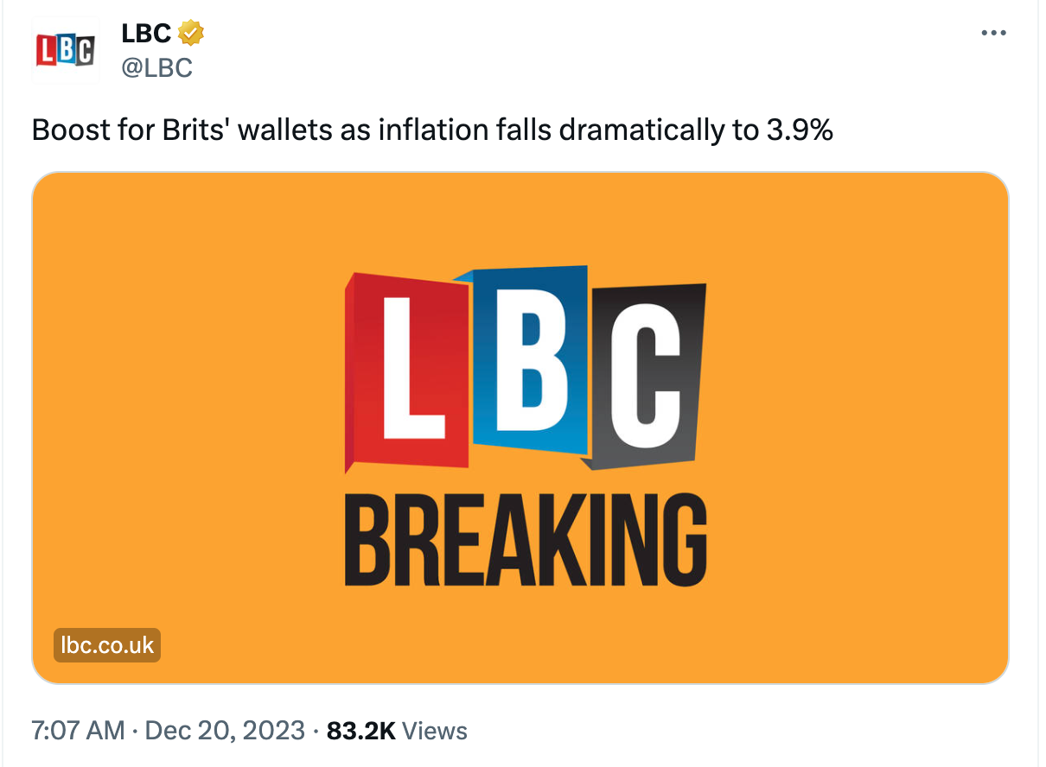
OPINION OR FACT?
Notes:
So let’s take out the question of which is the BETTER headline – and look a little more closely at what story the headline is really telling us. This one is from LBC – and this is the post of X they pout out that morning. Is this an OPINION or a FACT?
Open discussion – WHY is it one or the other. Is it factual, or just telling one part of the story?
[Add context here – as well as being an opinion, it’s also misleading “Boost for Brits’ wallets” suggests people will have MORE money – but the fact is, prices are still rising!

Slide 4
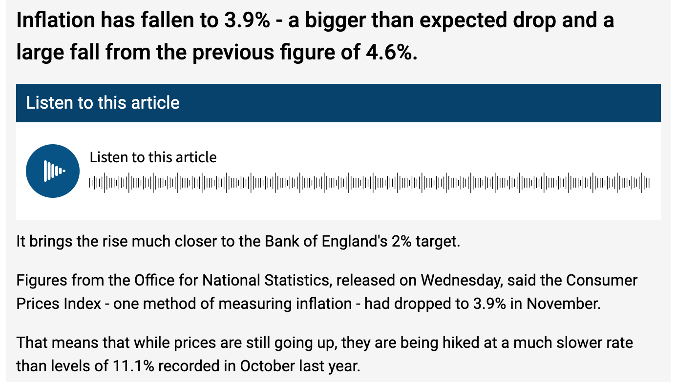
OPINION OR FACT?
Notes:
OK, let’s click on the post from X and see what we get – here’s the article – is it OPINION or FACT?
Widen discussion to difference between the HEADLINE and the ARTICLE. Was the headline framed in a particular way and why? (Click bait?)

Slide 5


OPINION OR FACT?
LBC 0800 News Bulletin
Notes:
So that was how LBC told the story online. Let’s listen now to how they presented it on the radio.
Was that OPINION or FACT? And why? Was it more factual than the article? Was it LESS opinionated than then post on X?
Why do do think that was?

Slide 6
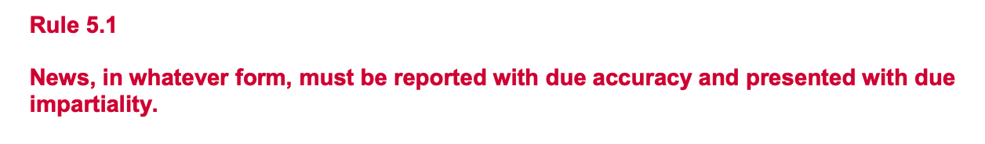

PRINT vs BROADCAST
Notes:
So we talked earlier about having the right to free speech. And we do. But when it comes to some types of journalism, there are regulations. In the UK, all broadcasters must stick to the OFCOM Broadcast Code. And here’s the important bit.
So what do we think impartiality means? OPEN DISCUSSION. CHALLENGE ASSUMPTIONS OF PURE BALANCE.

Slide 7

THE “BBC” WAY?
Radio 2 0800 News Bulletin
Notes:
So we’ve heard how a commercial radio station covers the story – here’s what the BBC did – this example from Radio 2.
PLAY CLIP
How did that differ from LBC? Was there more attention to impartiality or less? Why?

Slide 8
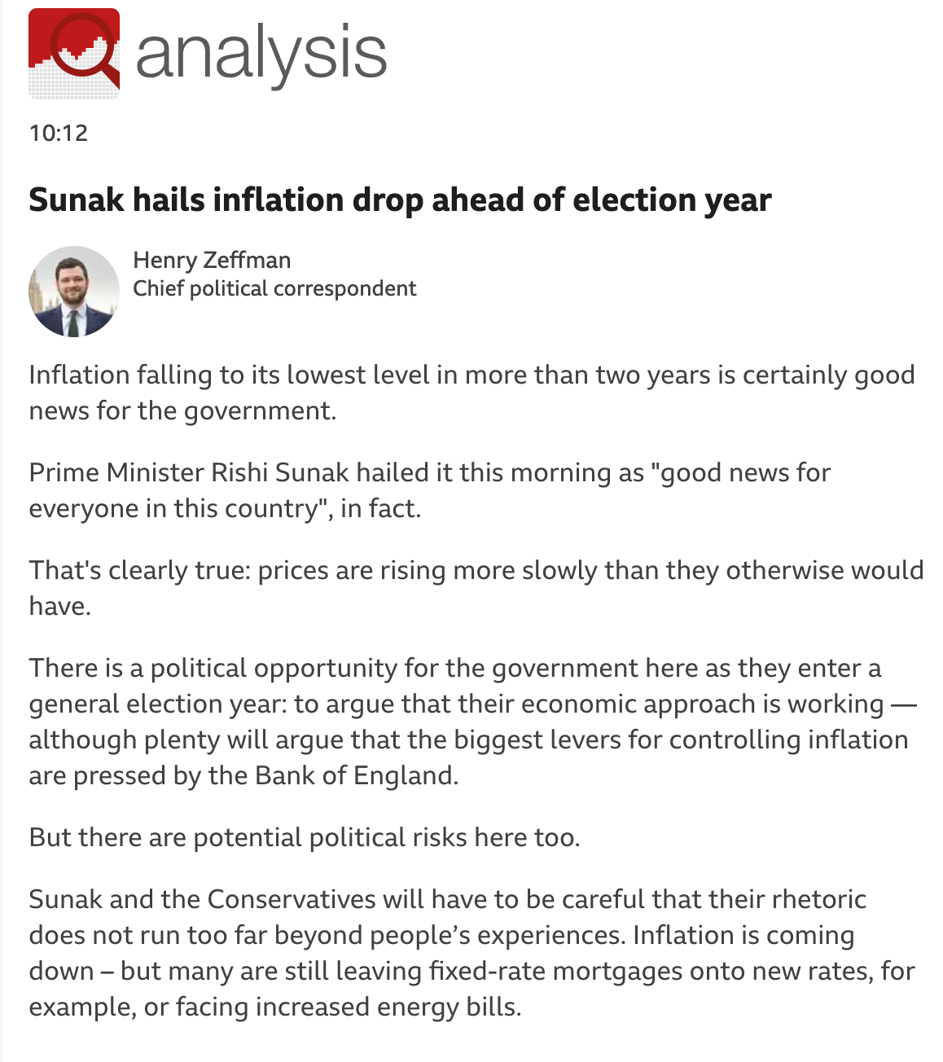
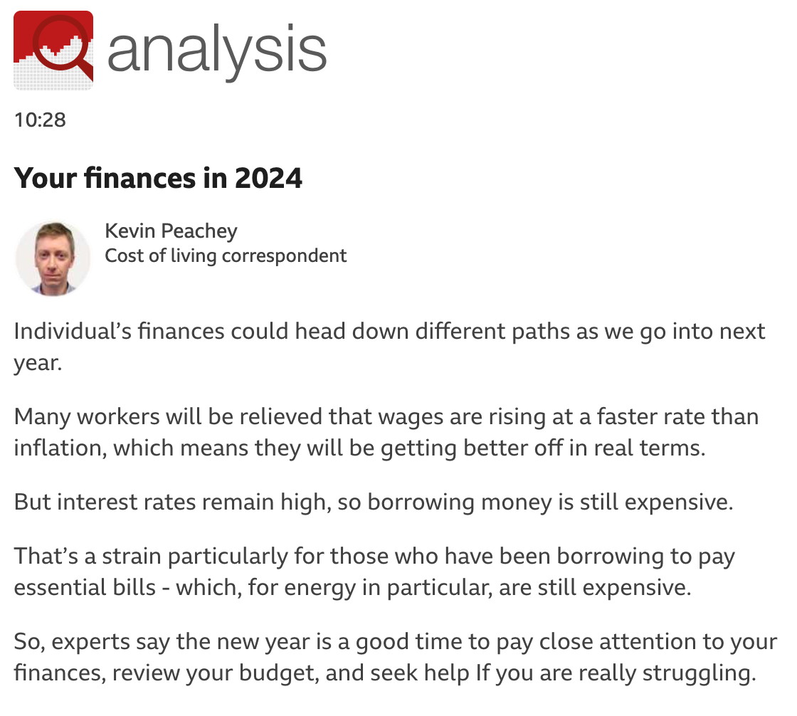
FACTS… AND ANALYSIS
Notes:
Now although the Ofcom regulations DON’T apply to Online text content – ie : a news website – the BBC goes further than most in trying to cover all sides of a story – especially if it’s a complex one like inflation. Here are two ANALYSIS BOXES from Chief Political Correspondent Henry Zeffernan and Cost of Living Correspondent Kevin Peachey. Each of these Correspondents is considered to be an expert in their field, and it’s their job to go into much more detail about the big stories. Let’s take a look at what Henry wrote…

Slide 9
OPINION … OR ANALYSIS?
Notes:
What do we make of this language? Is it OPINION or ANALYSIS?
Open up discussion – but explain that not EVERY item has to be TOTALLY BALANCED. Refer to Ofcom regulations and “due impartiality”. Explain that when it comes to regulation, balance can be achieved over time.
[If time, run a short exercise with resources of different opinions and how these could apply to a series of news broadcasts over a day]

Slide 10
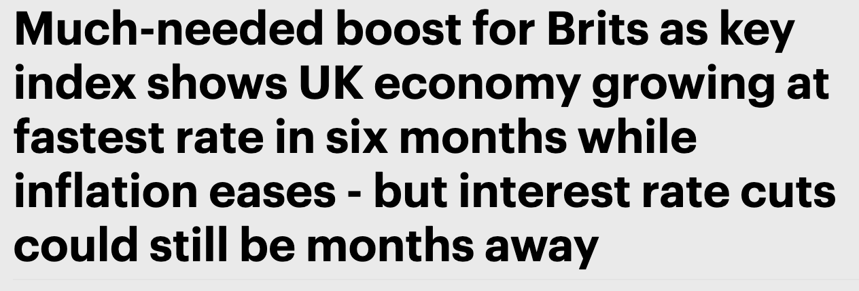

OPINION … OR ANALYSIS?
Notes:
So going back to that idea of balance… what do we make of this headline?
Open discussion. Explain that, unlike broadcasters, newspapers and online text outlets are not subject to the same impartiality rules.

Slide 11
RECAP
”Due” Impartiality applies to UK broadcasters
Balance “over time”
No opinions by newsreaders
Context and analysis permitted

